Slide 1
HOUSING: PRICE PREDICTION
Submitted by – Amruta Shah

Slide 2
Information
Houses are one of the necessary needs of each and every person around the globe and therefore housing and real estate market is one of the markets which is one of the major contributors in the world’s economy. It is a very large market and there are various companies working in the domain. Data science comes as a very important tool to solve problems in the domain to help the companies increase their overall revenue, profits, improving their marketing strategies and focusing on changing trends in house sales and purchases. Predictive modelling, Market mix modelling, recommendation systems are some of the machine learning techniques used for achieving the business goals for housing companies. Our problem is related to one such housing company.
A US-based housing company named Surprise Housing has decided to enter the Australian market. The company uses data analytics to purchase houses at a price below their actual values and flip them at a higher price. For the same purpose, the company has collected a data set from the sale of houses in Australia.

Slide 3
Problem Statement: -
The company is looking at prospective properties to buy houses to enter the market. You are required to build a model using Machine Learning in order to predict the actual value of the prospective properties and decide whether to invest in them or not. For this company wants to know:
Which variables are important to predict the price of variable?
How do these variables describe the price of the house?
Business Goal:
You are required to build model the price of houses with the available independent variables. This model will then be used by the management to understand how exactly the prices vary with the variables. They can accordingly manipulate the strategy of the firm and concentrate on areas that will yield high returns. Further, the model will be a good way for the management to understand the pricing dynamics of a new market.

Slide 4
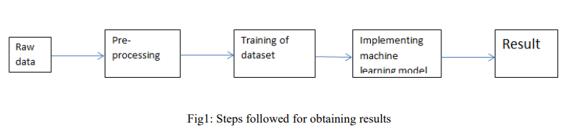
Methodology:-
The steps followed in this work, right from the dataset preparation to obtaining results are represented in Fig.

Slide 5
EDA (Exploratory Data Analysis):-
Import libraries: -
Import pandas as pd # for data manipulation
Import numpy as np # for mathematical calculations
Import seaborn as sns # for data visualization
Import matplotlib.pyplot as plt #for graphical analysis
%matplotlib inline
Import warnings # to ignore any warnings

Slide 6
Technical Requirements:
• Data contains 1460 entries each having 81 variables.
• Data contains Null values. You need to treat them using the domain knowledge and your own understanding.
• Extensive EDA has to be performed to gain relationships of important variable and price.
• Data contains numerical as well as categorical variable. You need to handle them accordingly.
• You have to build Machine Learning models, apply regularization and determine the optimal values of Hyper Parameters. If any.
• You need to find important features which affect the price positively or negatively.
• Two datasets are being provided to you (test.csv, train.csv). You will train on train.csv dataset and predict on
test.csv file.
The “Data file.csv” and “Data description.txt” are enclosed with this file.

Slide 7
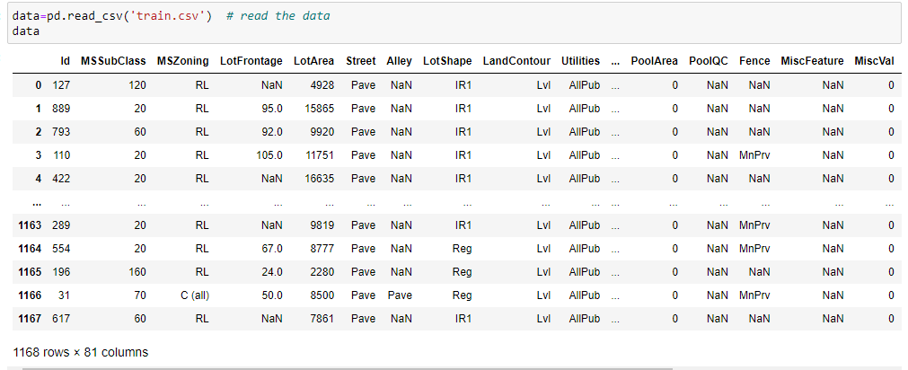
Load Dataset

Slide 8
Observations
There are 81 columns and 1168 rows in the this dataset
There are null values are present in this dataset.
We have categorical data type(object type).
Need to use pre-processing methods to convert categorical data to numerical.
Skewness and Outliers are present.
We can see that in most of the objective columns there in NA with some categorical value. Need to fill that value with one of category.
There is train and test dataset is present.

Slide 9
Data Visualization
We now have a basic idea about the data. We need to extend that with some visualizations. We are going to look at three types of plots:
Univariate plots to better understand each variable.
Bivariate plots to find relationship between two variables,
Multivariate plots to better understand the relationships between variables.

Slide 10
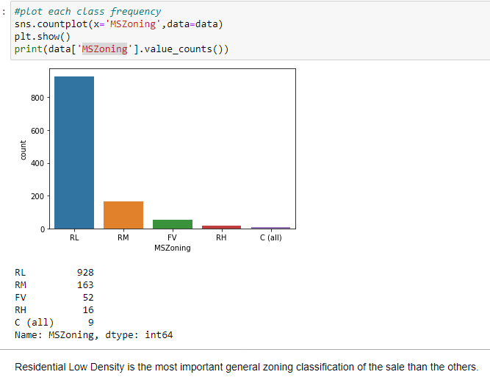
Univariate Plots:-

Slide 11
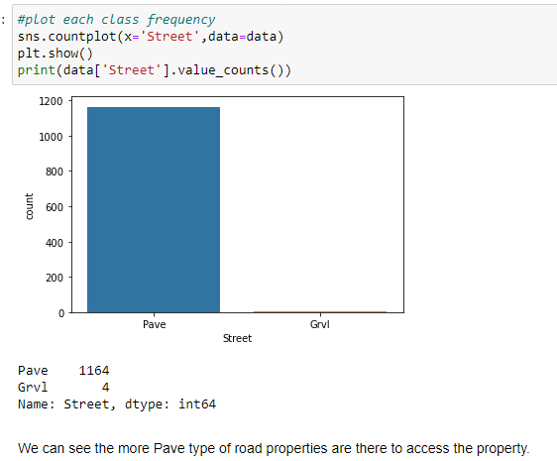

Slide 12
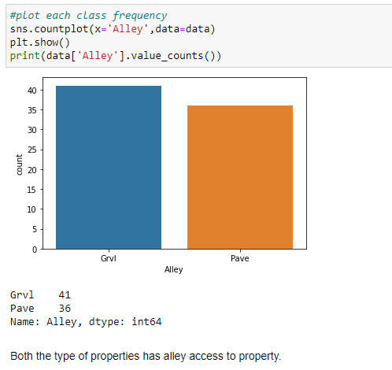

Slide 13
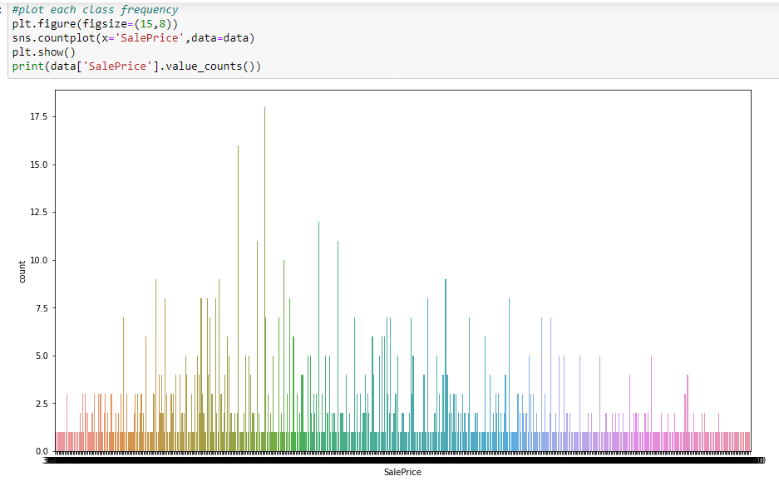

Slide 14
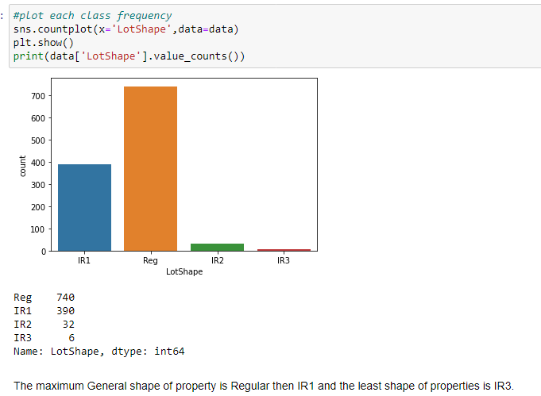

Slide 15
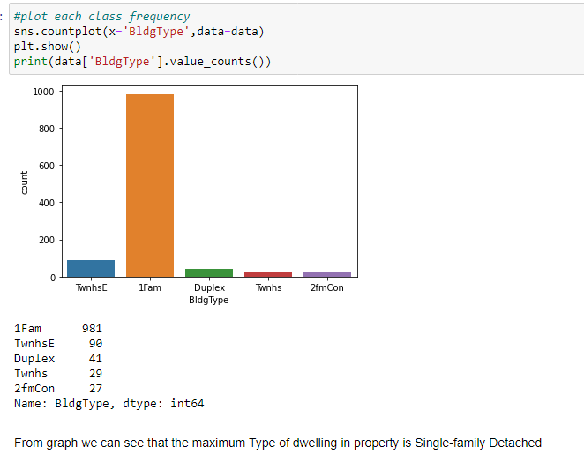

Slide 16
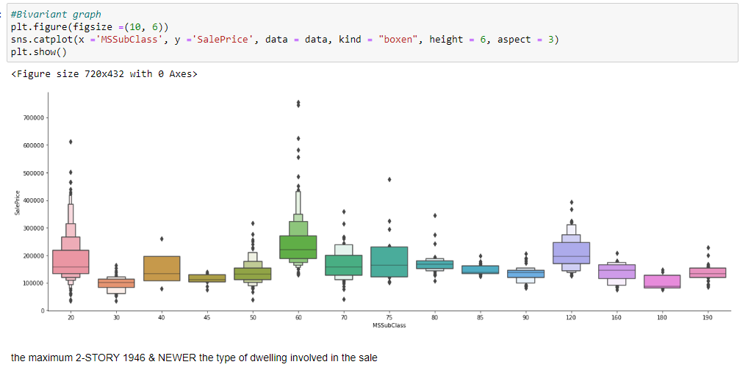
Bivariate Plot

Slide 17
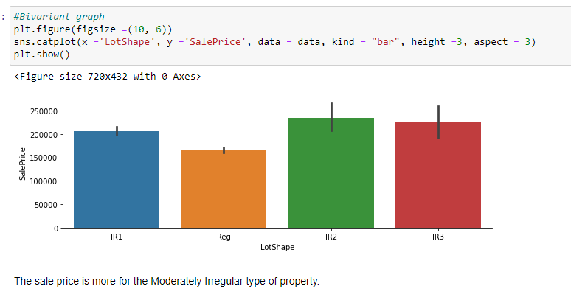

Slide 18
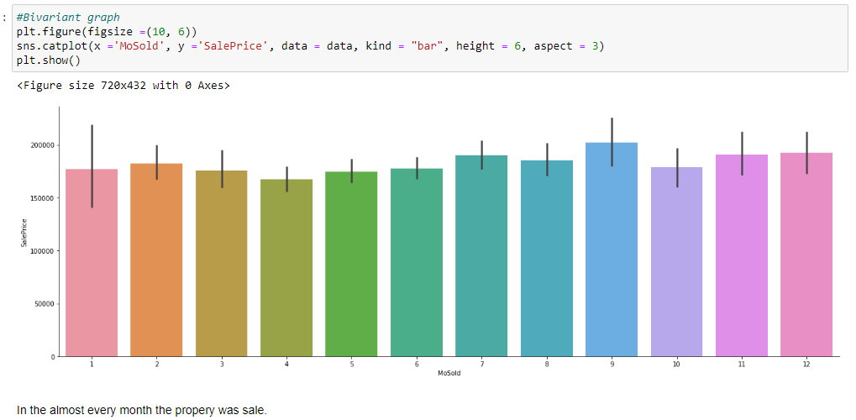

Slide 19
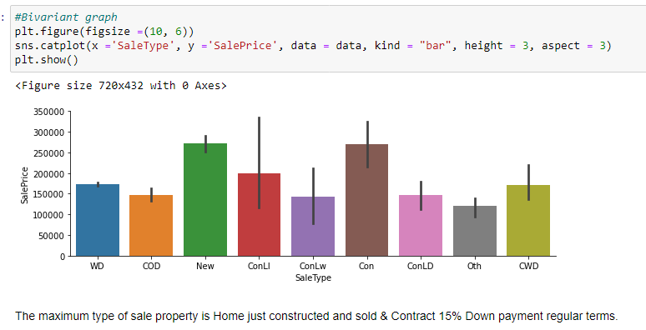

Slide 20
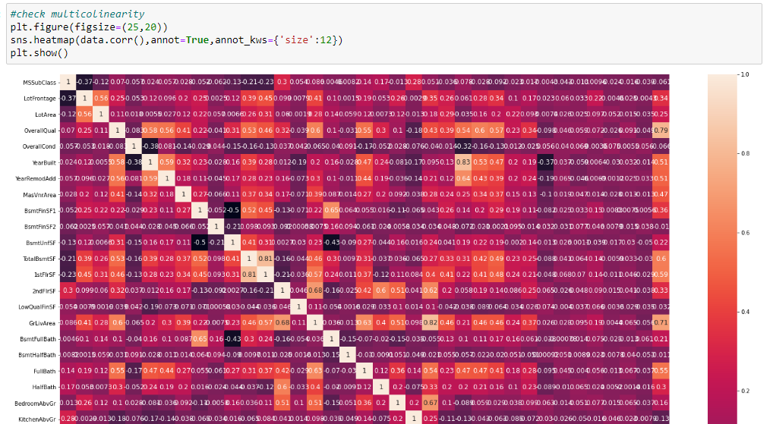
Multivariate Plot

Slide 21
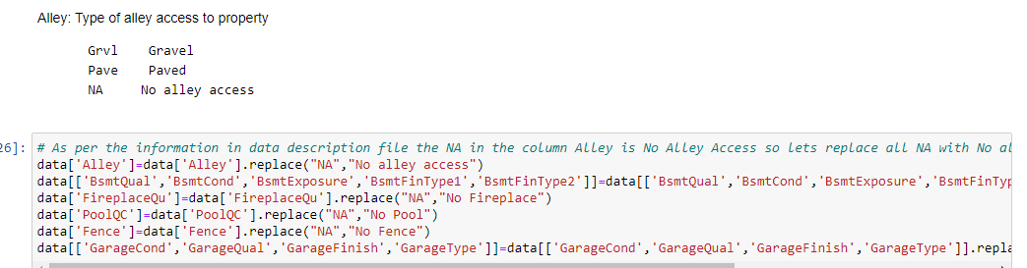
Data Pre-processing:-
In this dataset there are some objectives are mentioned as NA so first lets change to particular value as per mentioned in data description. Refer below fig.

Slide 22
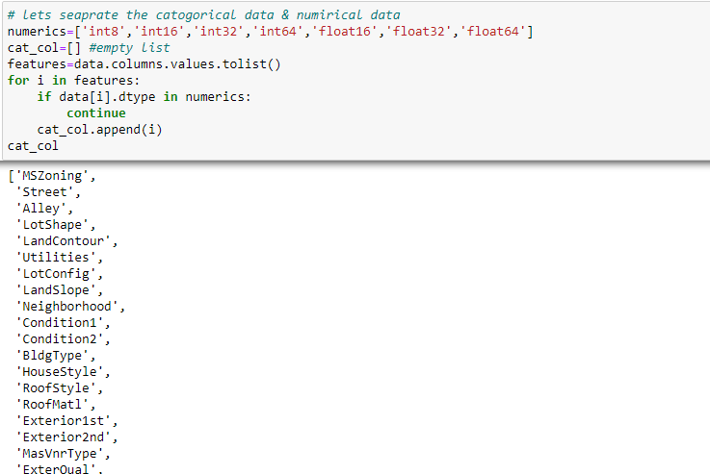
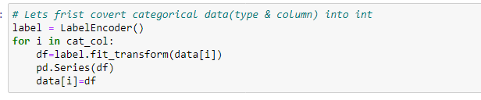
Separating data & Encoding :-

Slide 23
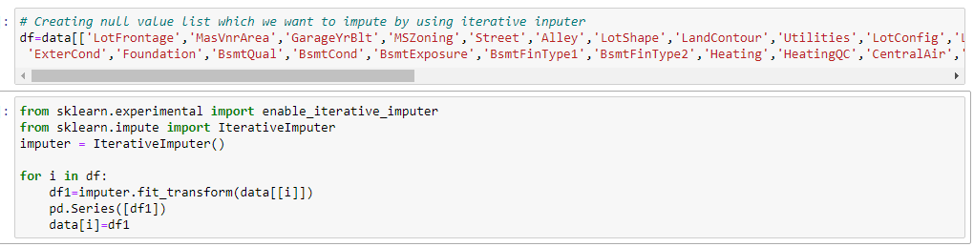
Iterative imputer

Slide 24
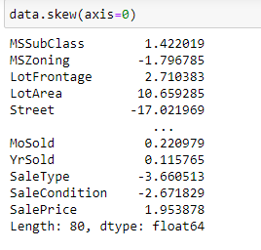
Check Skewness

Slide 25
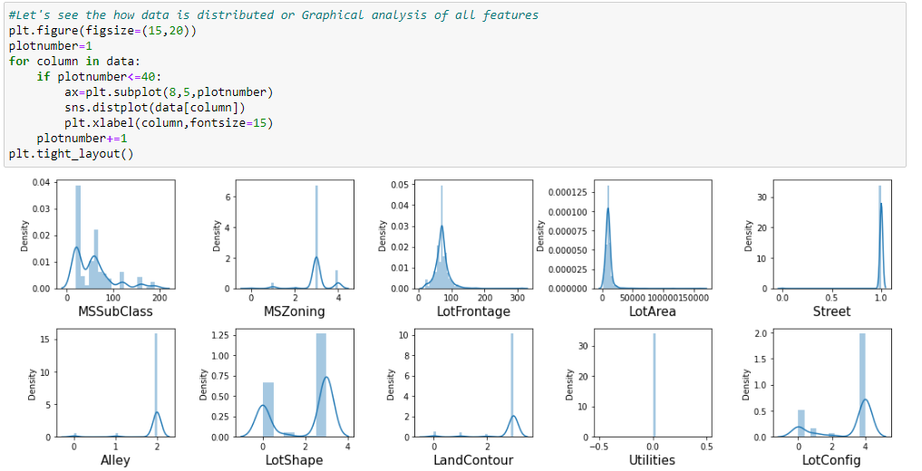
Distribution plot for skewness

Slide 26
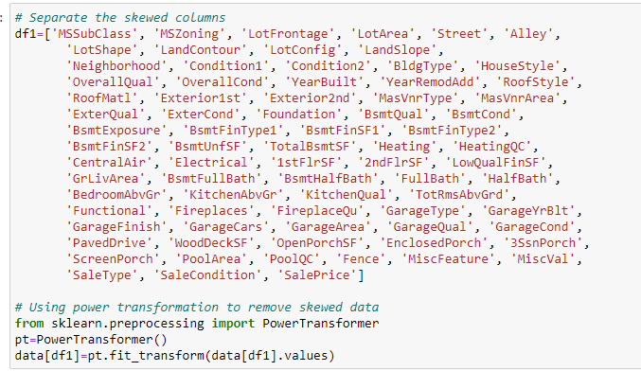
Power Transformation to remove skewness

Slide 27
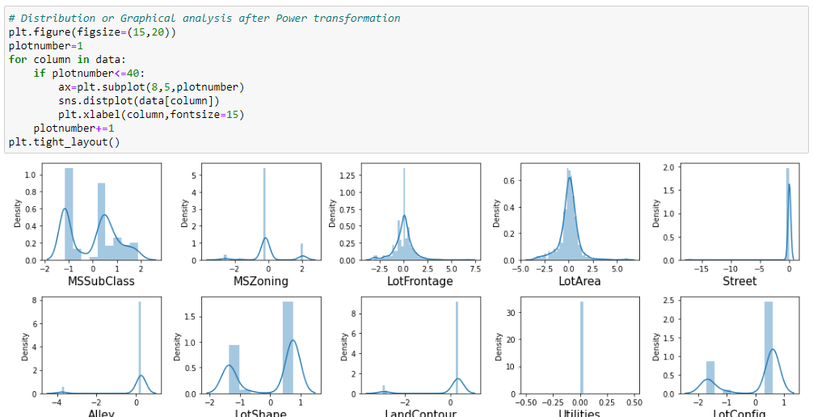
Distribution after removing skewness

Slide 28
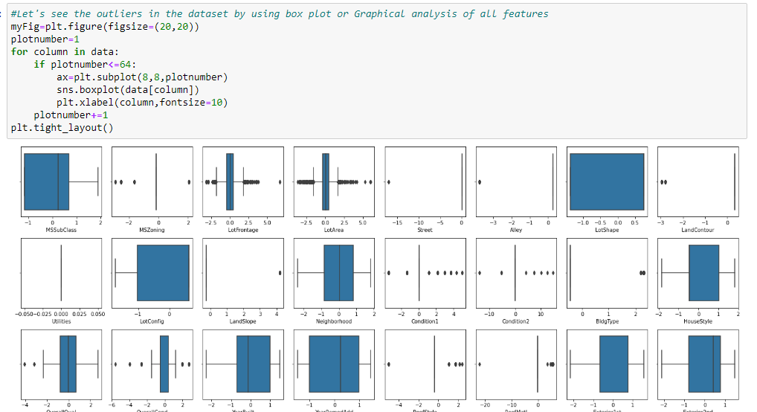
Distribution to see outliers

Slide 29
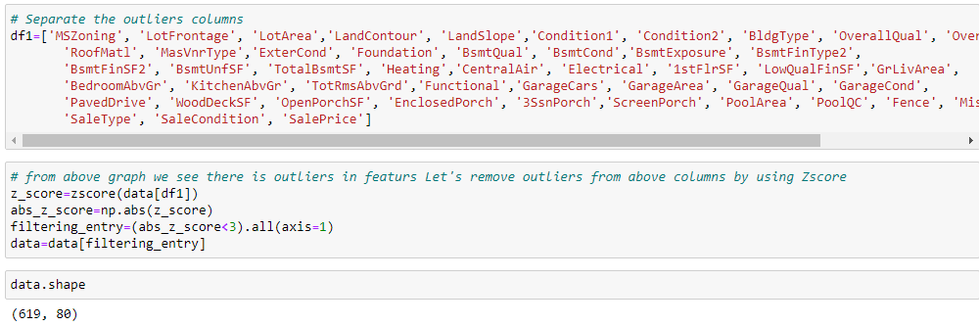
ZScore to remove outliers

Slide 30
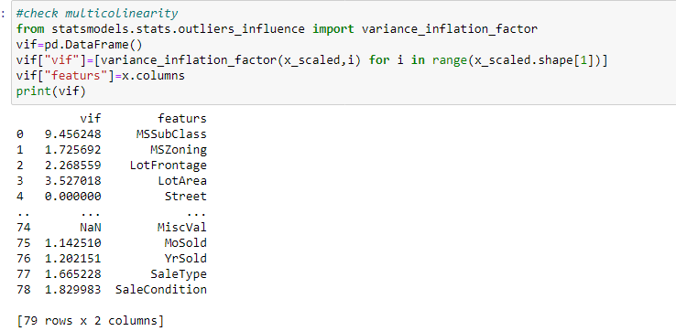
Multicollinearity by VIF

Slide 31
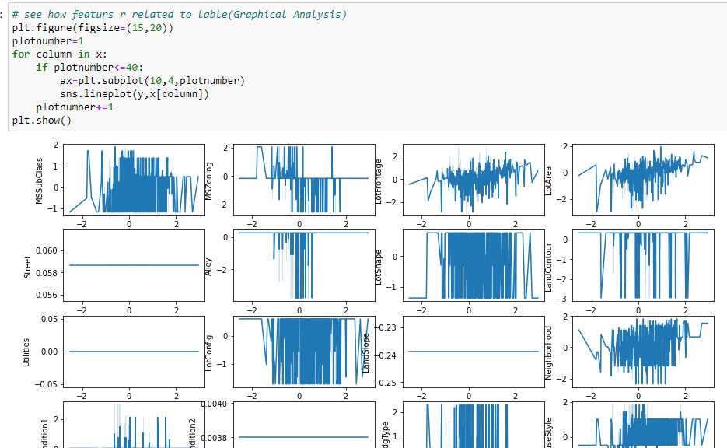

Slide 32
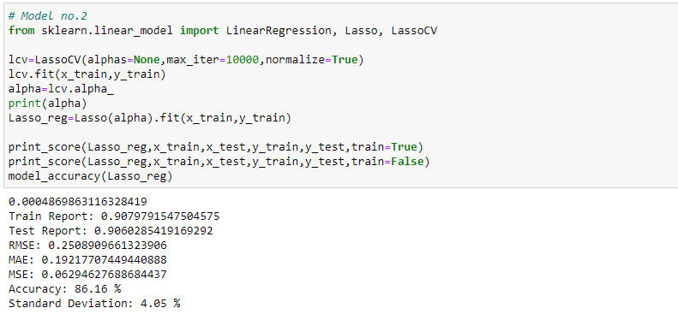
Build the models & select best one

Slide 33
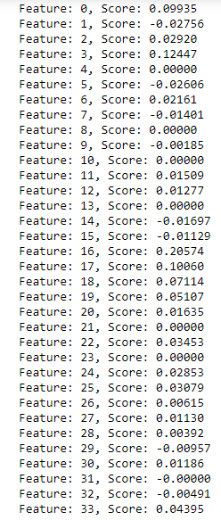
Feature importance using the LASSO:

Slide 34
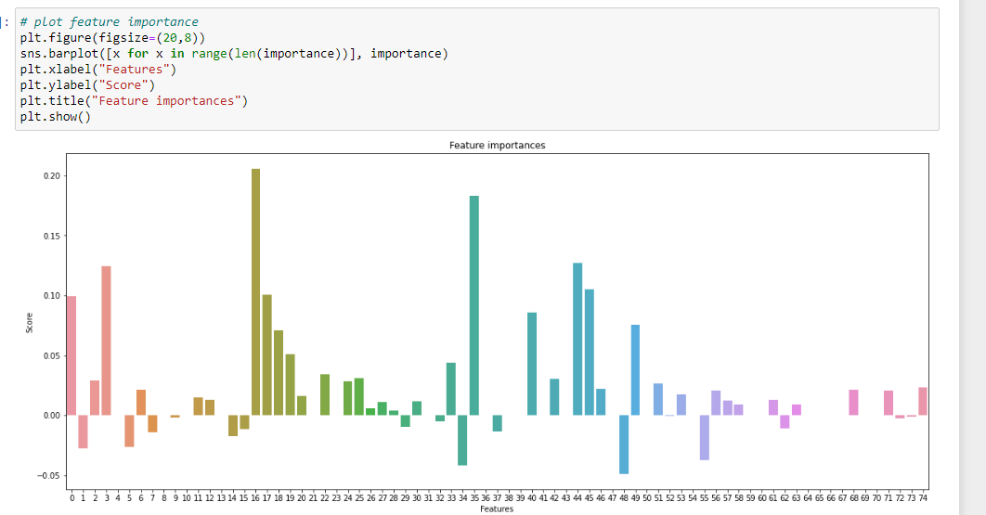

Slide 35
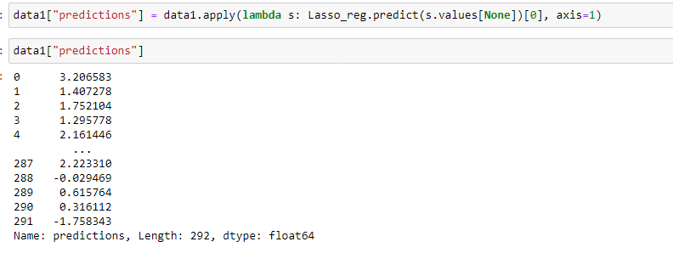
Now, lets predict the sales price by using the saved Lasso Regression Model on test data.

Slide 36
In this project we build the regression model that can predict sales price of house. The challenge behind predicting models is EDA & feature selection. We have gone through how to implement the entire machine learning pipeline, and we have an intuitive understanding of machine learning algorithms. The larger the dataset gets, the more complex each of the mentioned steps gets. Therefore, using this as a base will help while you build your knowledge of machine learning pipelines. This Paper has presented a supervised housing sales price learning model which used machine learning algorithms to predict the price. We used different machine learning algorithm to check the accuracy of price prediction.
Conclusion and Future Scope: -

